Slide 1
Currency Converter
Created by: aayush Gautam
Programming language: java

Slide 2

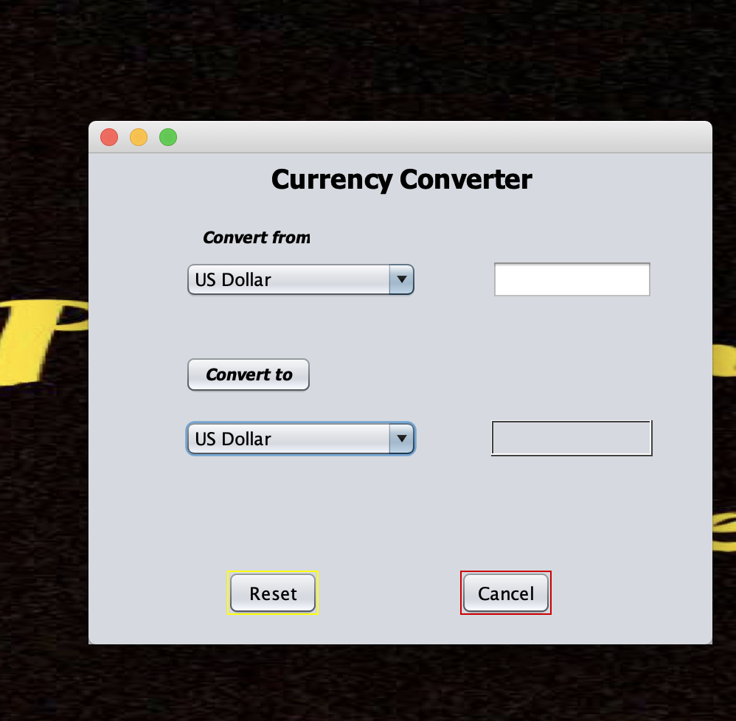
Purpose of the project
Convert the currency
I have put 4 different currency from four different countries with different exchange rate.
Currency I used are Euro, Dollar, Pound and Nepalese Rupees.
It will ask user to convert from one currency to another from available four list of currency.

Slide 3
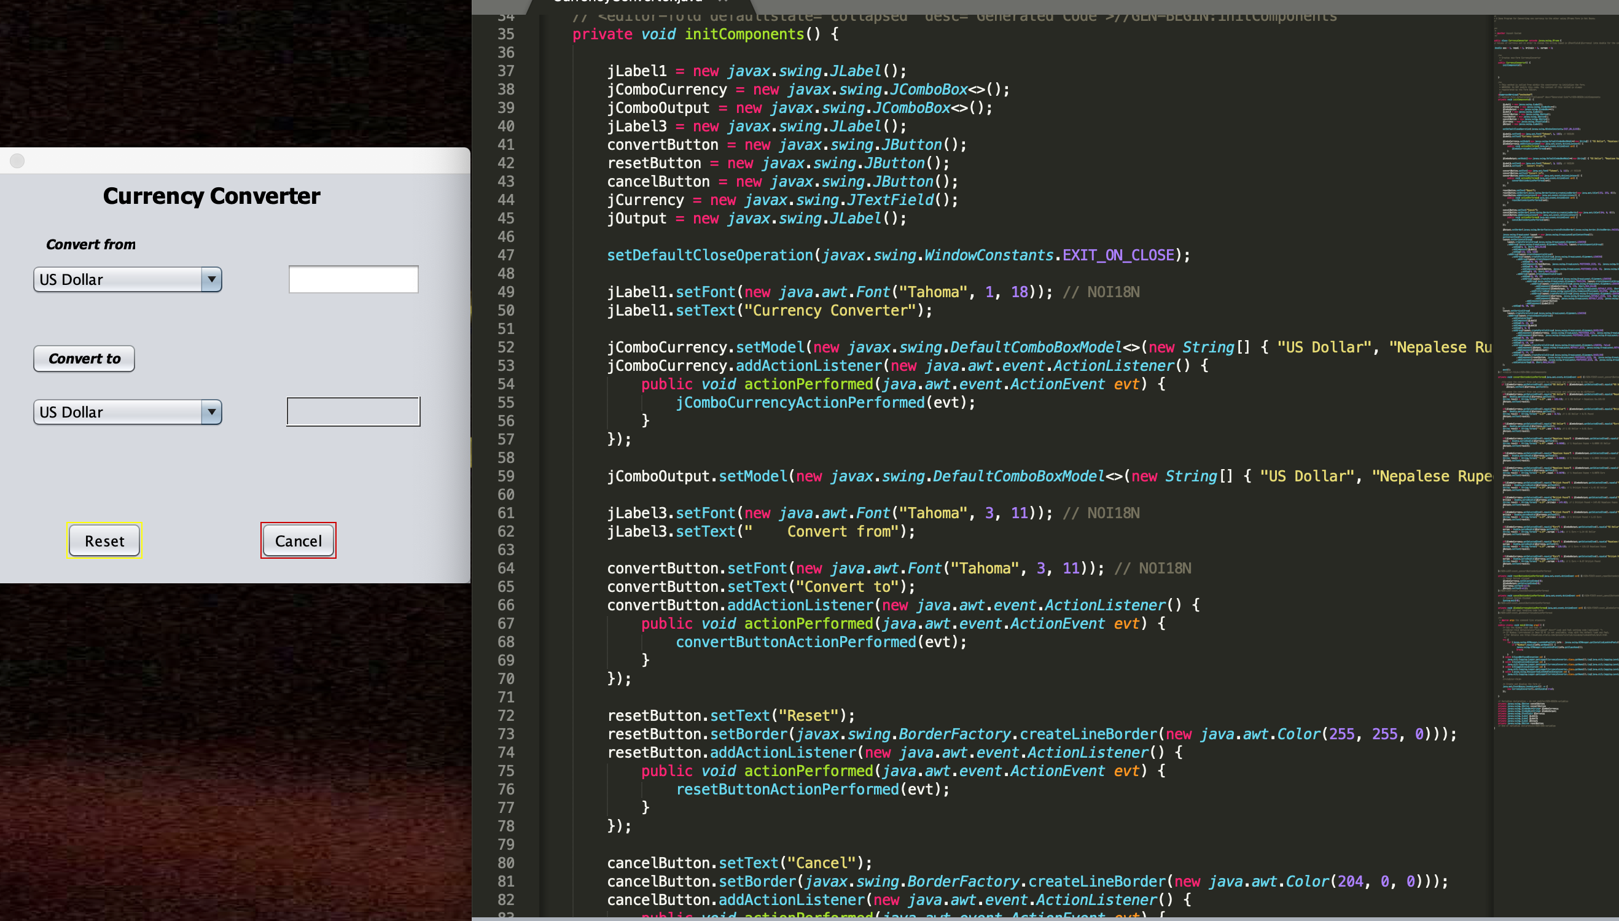
Engineering:
Graphical user interface (GUI)
Creation of buttons, boxes
Font design and size of text

Slide 4
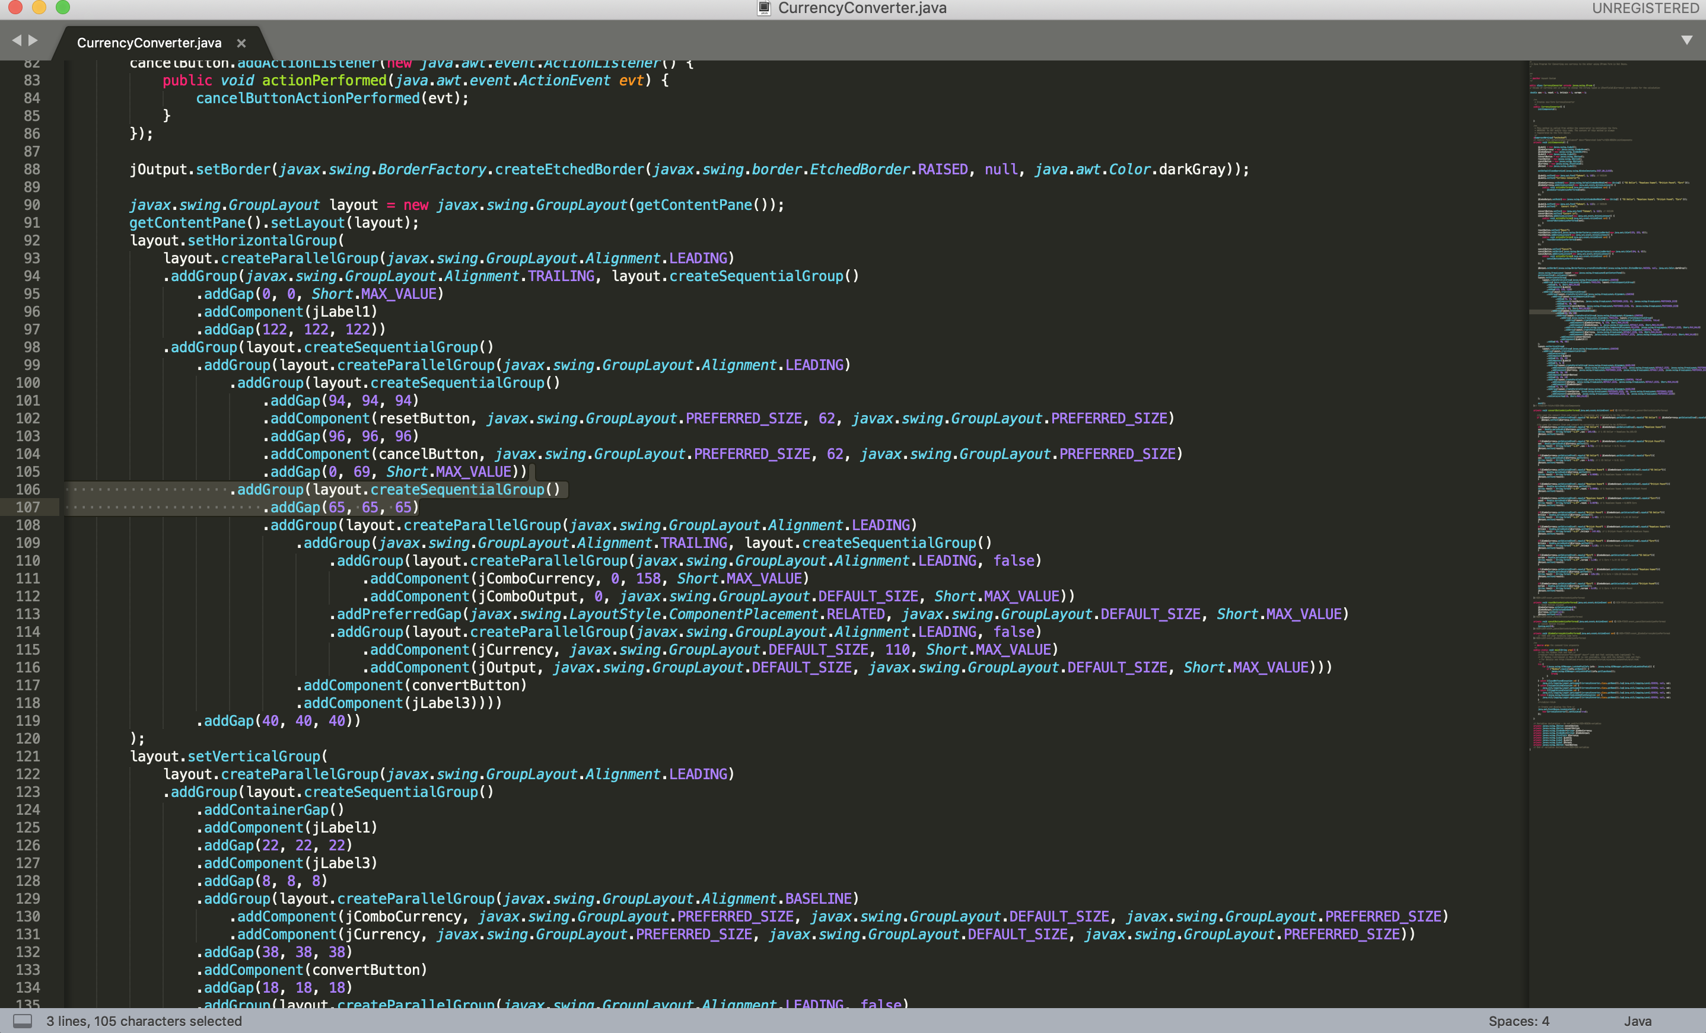
Cascading Style Sheet (css)
Engineering sizes, font and buttons for GUI .

Slide 5
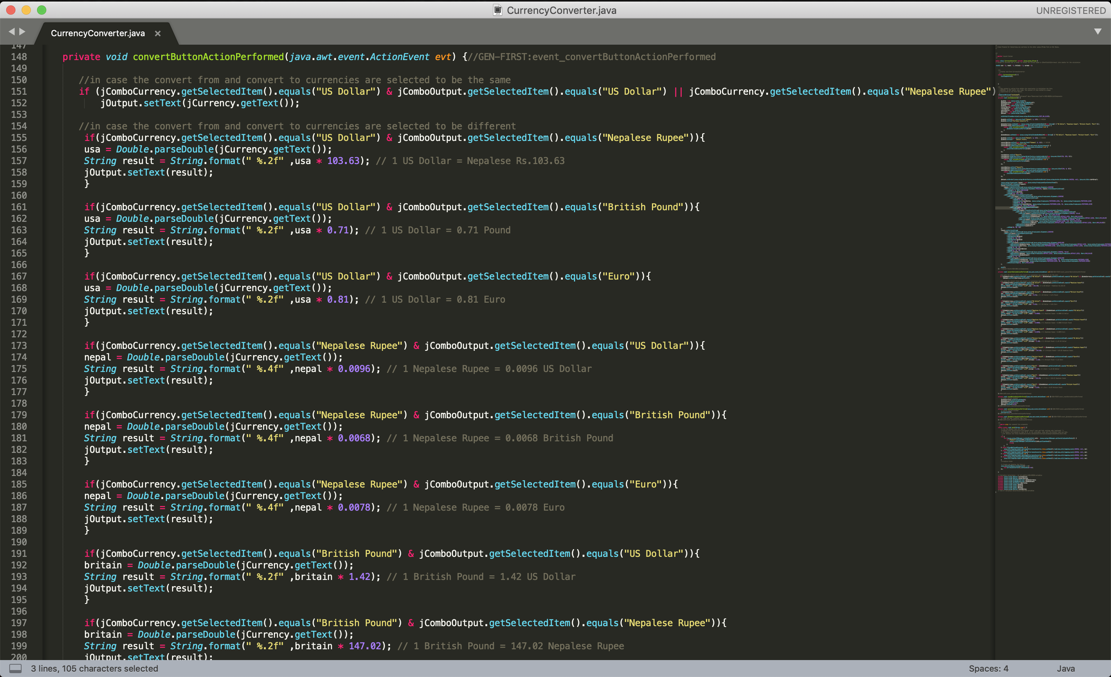
Conditions:
If and logical operands
Paper prototype for all necessary condition with exchange rate of each country.

Slide 6
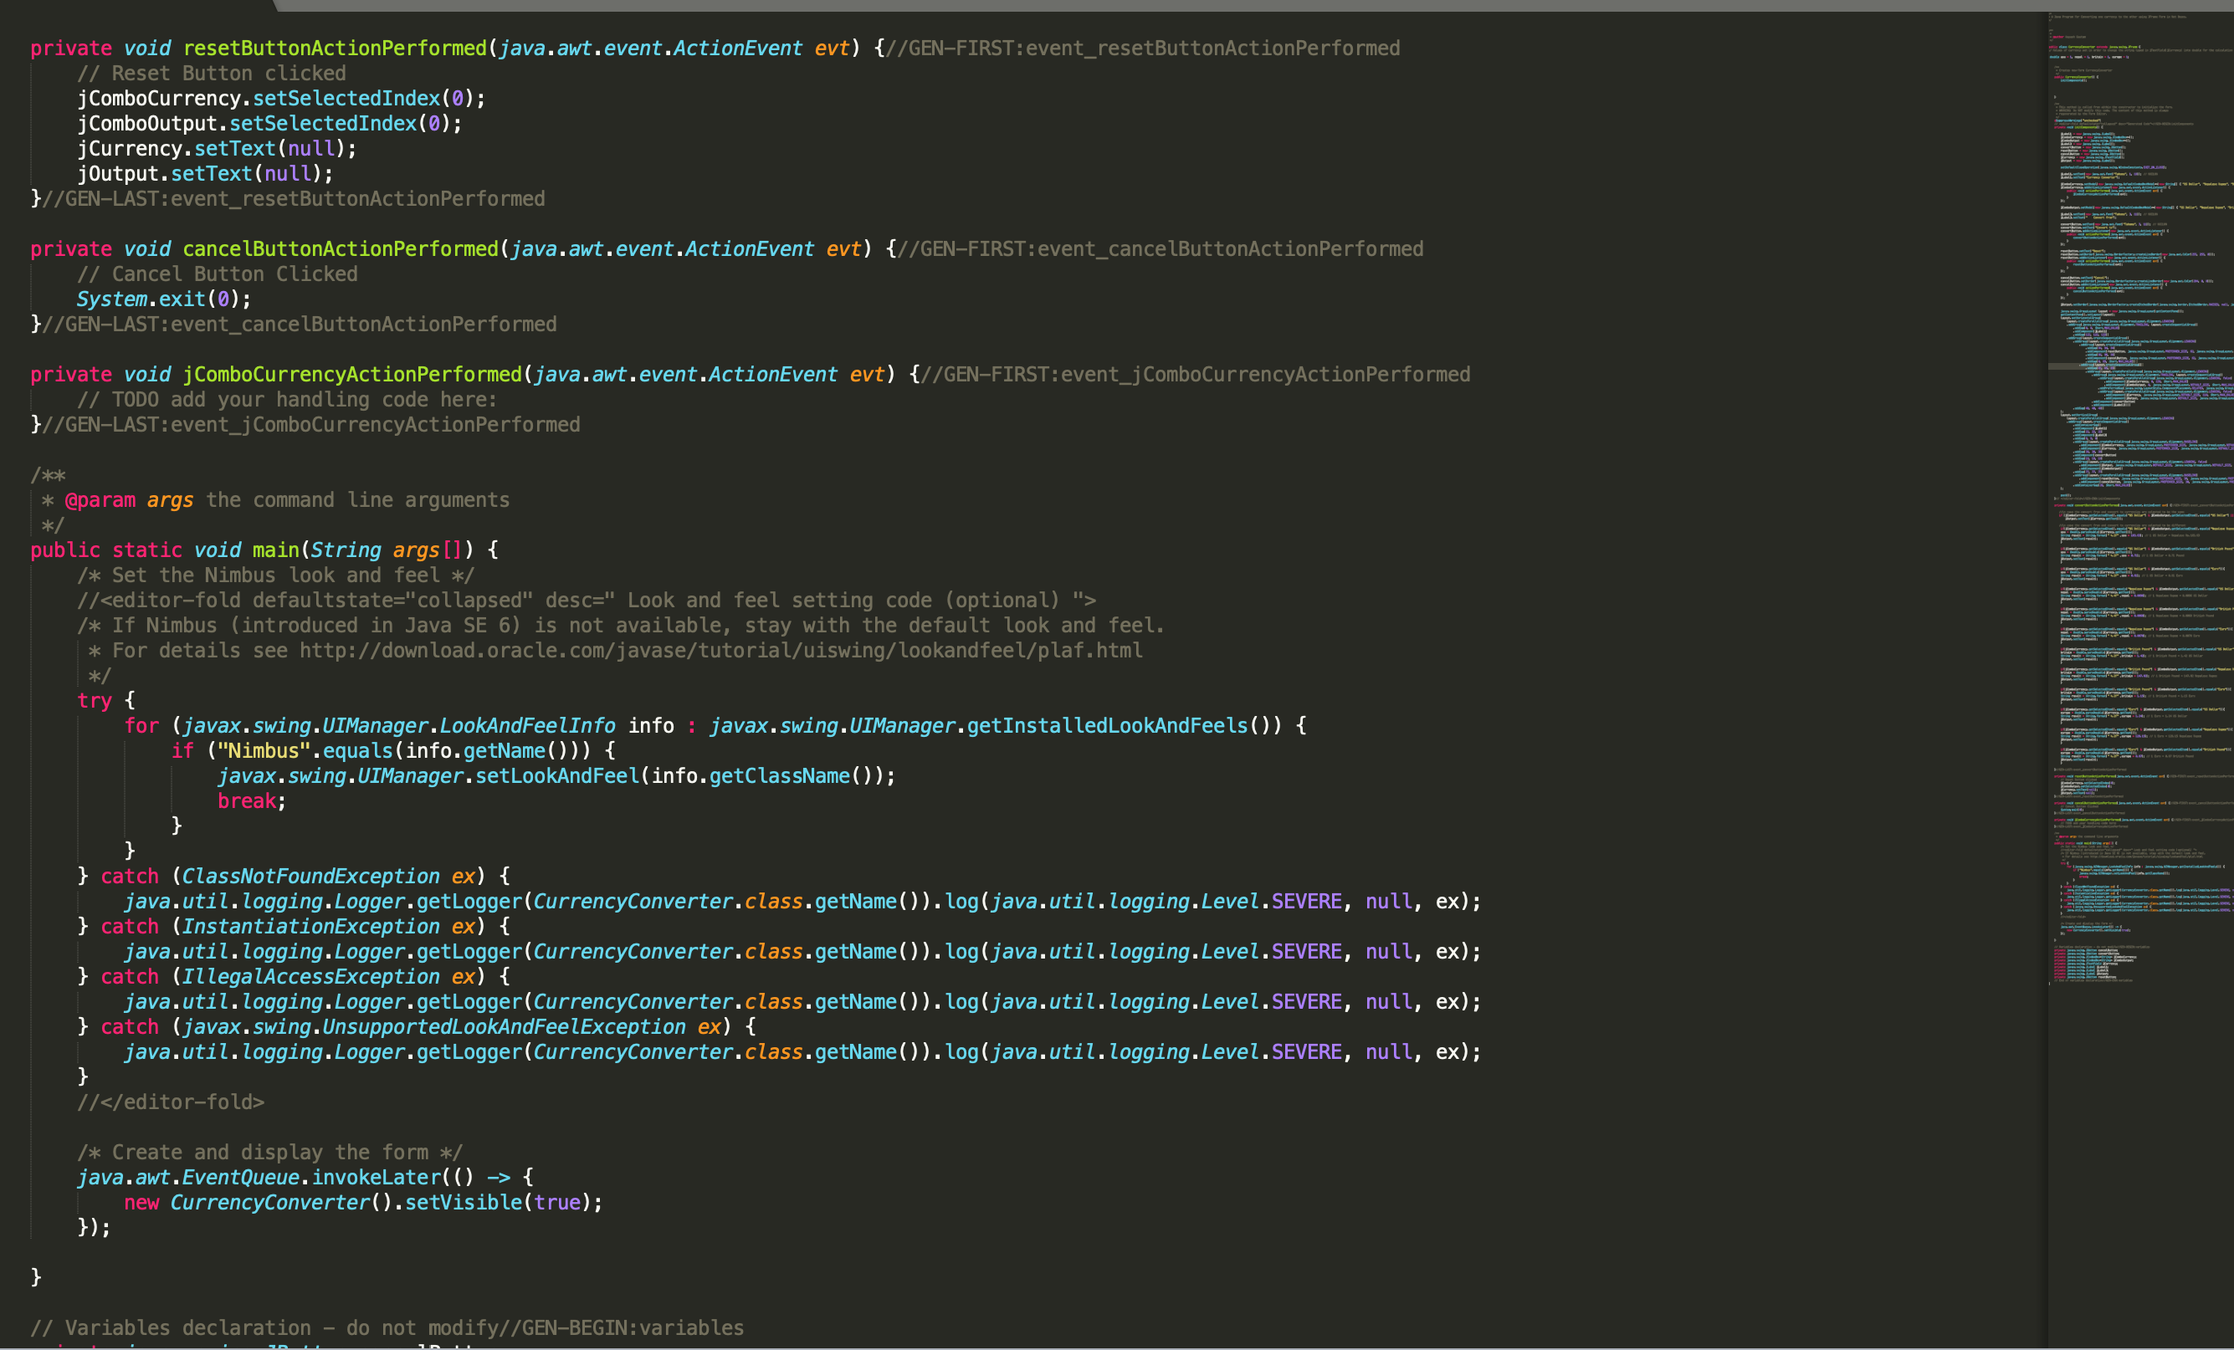
Reset and Cancel
To test new value of currency
And to quit the program

Slide 7
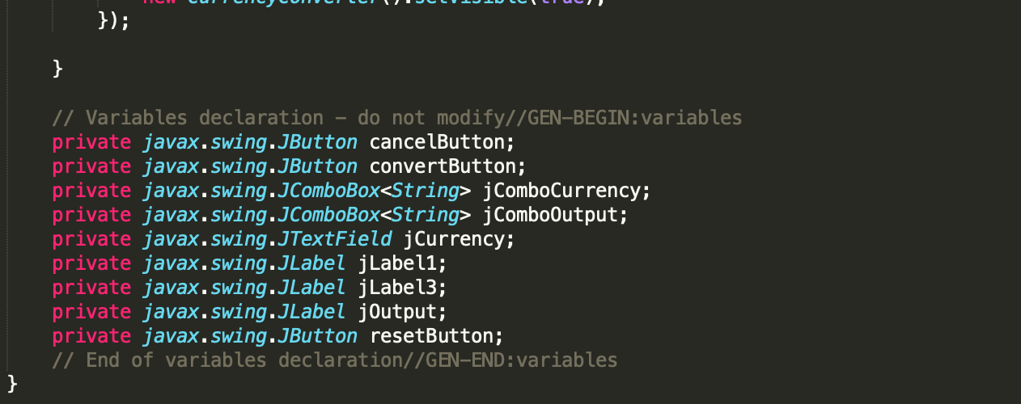
declaration
s
A variable is only a name given to a memory location, all the operations done on the variable effects that memory location.

Slide 8
References:
www.w3school.com
www.youtube.com
www.stackoverflow.com
www.udemy.com
All the assignment presented by Jonny Williams.

